Slide 1
AI Support Assistant
TEAM: TRAGICBYTES
Team Members: Vedang Wajge Bhagyesh Patil
Soham Satpute Laksh Sodhai

Slide 2
Objectives : Steps Implemented
AI-Powered Intelligent Support The chatbot uses advanced NLP (e.g., GPT, Gemini AI) for natural language understanding, contextual conversation handling, and intent recognition to resolve user queries efficiently.
Self-Updating Knowledge Base A dynamic, structured repository (e.g., MongoDB) enables easy content management, while the chatbot continuously learns from user interactions and feedback to improve accuracy over time.
Real-Time ERP Data Access Integrated via RESTful APIs with secure OAuth2 authentication, the chatbot fetches real-time data (Sales, HR, Finance) to provide users with instant, actionable insights directly within the chat.
Multi-Channel and Scalable Access Accessible across web, WhatsApp, Teams, Slack, and email, with future support for voice-based interactions, ensuring widespread adoption and user convenience.

Slide 3
Objectives : Steps Implemented
Efficient Escalation and Security Automatically escalates unresolved queries to human support, while role-based access ensures users only access data relevant to their permissions, maintaining security and compliance.
Insightful Analytics and Reporting A centralized dashboard (e.g., via Power BI/Tableau) offers performance monitoring, user query trends, and knowledge base gaps, enabling data-driven improvements and support optimization.

Slide 4
Challenges And Solutions:
Complex Query Understanding
Challenge: Handling multi-part, context-heavy queries from users.
Solution: Used fine-tuned NLP models, multi-step intent recognition, and context-aware conversation flow.
Real-Time Data Integration
Challenge: Securely and efficiently fetching ERP data without delays.
Solution: Used RESTful APIs with OAuth2, caching, and asynchronous data fetching for speed and security.
Multi-Channel Support
Challenge: Ensuring consistent chatbot behavior across platforms (e.g., WhatsApp, Teams).
Solution: Modular backend, platform-specific SDKs/webhooks, and extensive cross-platform testing.

Slide 5
Challenges And Solutions:
4.Knowledge Base Management
Challenge: Updating content easily while maintaining relevance and accuracy.
Solution: Built an admin dashboard, AI-driven content checks, and a feedback loop for knowledge updates.
5.Role-Based Access Control
Challenge: Delivering secure, role-specific data to users.
Solution: Integrated RBAC using ERP roles, with secure authentication and thorough testing.

Slide 6
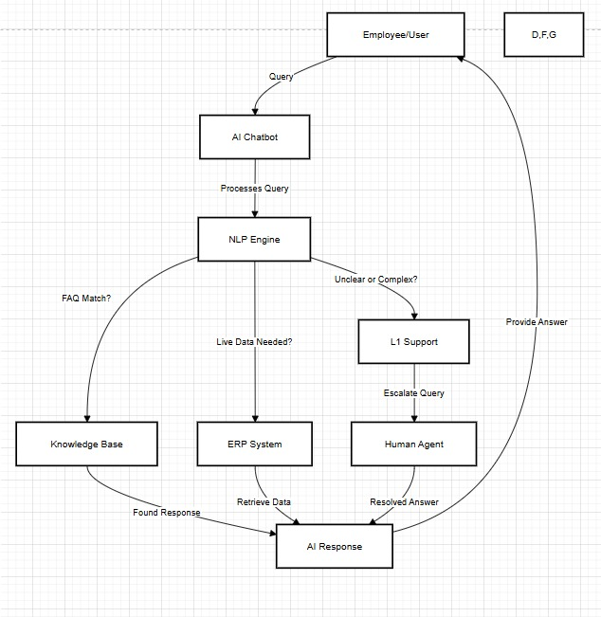
Solution Architecture DFD Diagram:

Slide 7
Tech Stack:
User Interface Layer
Platforms: Web (React.js), WhatsApp (Twilio API), Microsoft Teams (Bot Framework SDK), Slack (Slack SDK), Email
AI Chatbot Engine
Backend: Node.js with Express.js
NLP Models: OpenAI GPT-4 / Google Gemini AI, spaCy, HuggingFace Transformers
Knowledge Base Management
Database: MongoDB
Admin Dashboard: React.js (Frontend) + Node.js (Backend)
ERP System Integration
RESTful APIs with OAuth2 Authentication
Middleware/API Gateway: AWS API Gateway or Kong

Slide 8
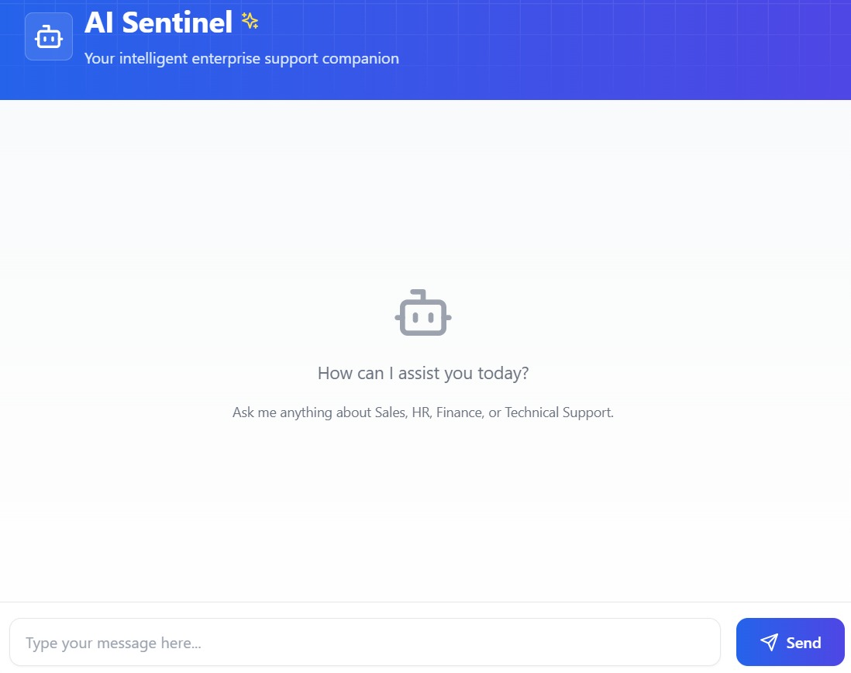
Project Screenshot:

